Slide 1

Universal Medical Form Reader
Project Results
This document was written in August 2021

Slide 2
Universal Medical Form Reader
Contents
Capabilities of the system......................................................................................... 4
Accuracy and Error rates.......................................................... 12
Limitations, Potential and Future Outcomes...................................................... 13

Slide 3
Universal Medical Form Reader
Pre-requisites for the running
Mandatory
Python (Latest Version)
Anaconda
Libraries/dependencies
Spyder
Notepad
Optional
Adobe Acrobat

Slide 4
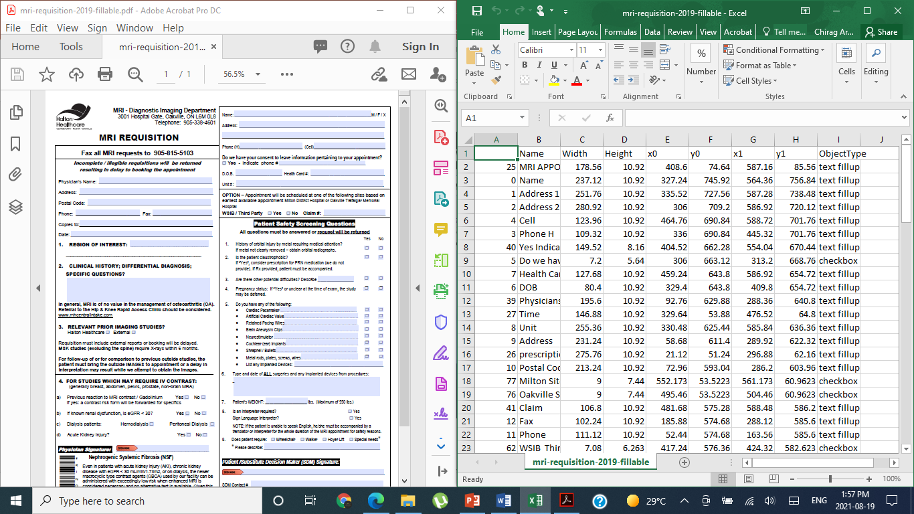
Universal Medical Form Reader
Capabilities of the system
Automatically extract all the elements from a PDF Form
Checkbox
Textbox
Plain Text

Slide 5
Universal Medical Form Reader
Capabilities of the system
Automatically assign labels to Textboxes and Checkboxes.
Potential Label
Textbox

Slide 6
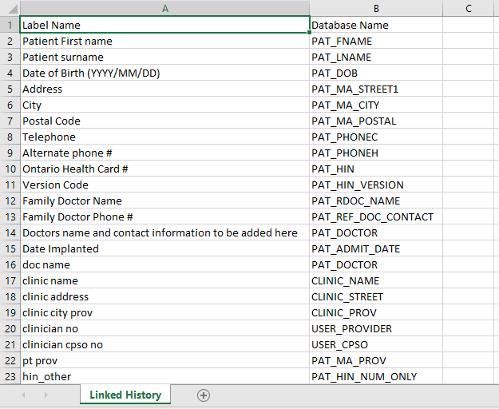
Universal Medical Form Reader
Capabilities of the system
Automatically Finds Relevant Database Names for Textboxes and Checkboxes
Linked History
Generates the database name

Slide 7
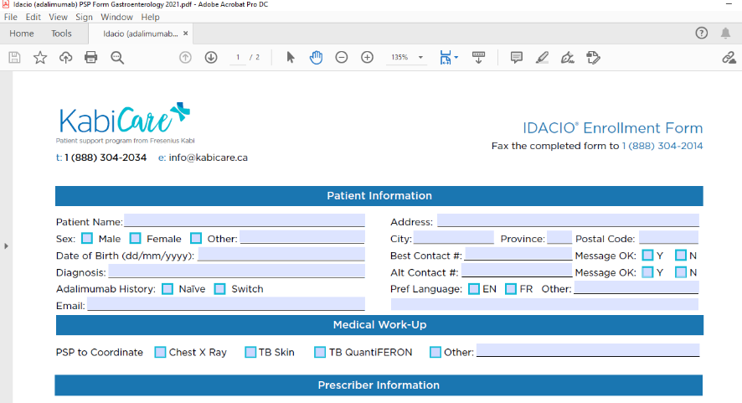
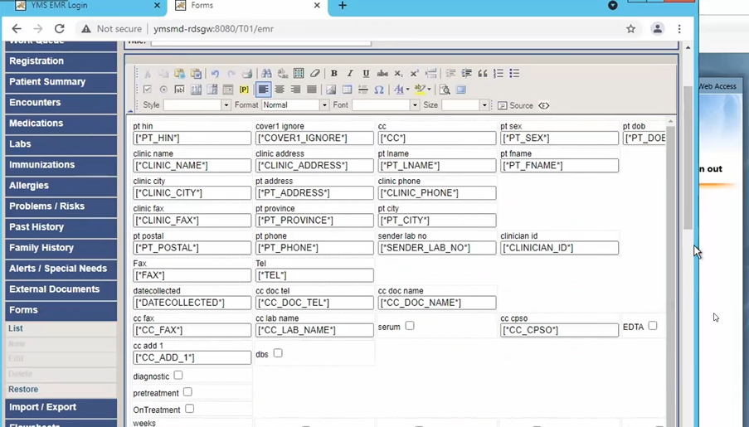
Universal Medical Form Reader
Capabilities of the system
Automatically HTML Script with Correct Formatting that Suits the System.

Slide 8


Universal Medical Form Reader
Accuracy and Error rates
Time spent per form was reduced from 12 – 15 hours to just 2 -3 hours.
Manual Effort reduced by 80%

Slide 9
Universal Medical Form Reader
Accuracy and Error rates
Software script is able to extract 85% of the elements of the file.

Slide 10
Universal Medical Form Reader
Accuracy and Error rates
Automated label assignment is accurate to about 50%.
General accuracy varies between 40-50% based on the pre-prepared forms.

Slide 11
Universal Medical Form Reader
Accuracy and Error rates
No doubt there were some exceptional cases where the results were not as desired, but this system worked for 70% of given general pdf files and produced satisfying results. It is believed that the 60-70% of manual efforts will be decreased by this system.

Slide 12
Universal Medical Form Reader
Accuracy and Error rates
Task | Automation Level | Accuracy
Unlocking PDFs | 0 | 0
Converting PDFs to Fillable | 60% | Adobe accuracy varies between 60 – 70%
Extracting Elements | 85% | 80-100%
Assign the Labels | 50% | 40-50%

Slide 13
Universal Medical Form Reader
Limitations, Potential and Future Outcomes
Form reader cannot currently unlock encrypted PPTs.
Cannot extract data from with images on a PDF (5% data from all the forms)
Cannot extract textboxes or checkboxes with winding fonts
(10% data from all the forms)
Form reader has low accuracy on finding labels. (40-50%)
Currently just a script, which has no interface.

Slide 14
Universal Medical Form Reader
Limitations, Potential and Future Outcomes
Flask and Rest to Develop API for the Python script to be integrated with the system.
JavaScript to find interactive textboxes and checkboxes which contain windings fonts.
Use better probabilistic algorithm to improve classification of labels from forms.
Computer Vision Machine Learning Techniques to extract subheading from images in the form.

